Slide 1
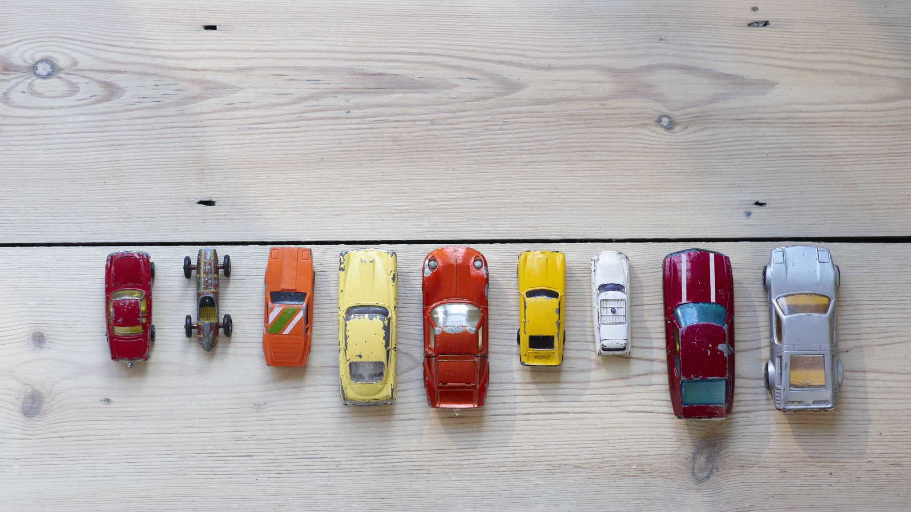
AUSTRALIA CAR PRICE PREDICTION: USING MULTILINER REGRESSION MODELING:
PROJECT BY:
SRUTHI

Slide 2
AGENDA:
INTRODUCTION
OBJECTIVE
TECHNOLOGY USED
SYSTEM DESIGN
EXPERIMENT AND RESULTS
CONCLUSION

Slide 3

INTRODUCTION: From a long time since being, there are two ways in which the selling of the items is carried out. One is offline and the other being online.

Slide 4
OBJECTIVE:
To build a supervised machine learning model for forecasting value of a vehicle based on multiple attributes.
The system that is being built must be feature based.
Providing graphical comparisons to provide a betted view.

Slide 5
TECHNOLOGY USED:
SCIPY
Matplotlib
Seaborn
Linear Regression

Slide 6
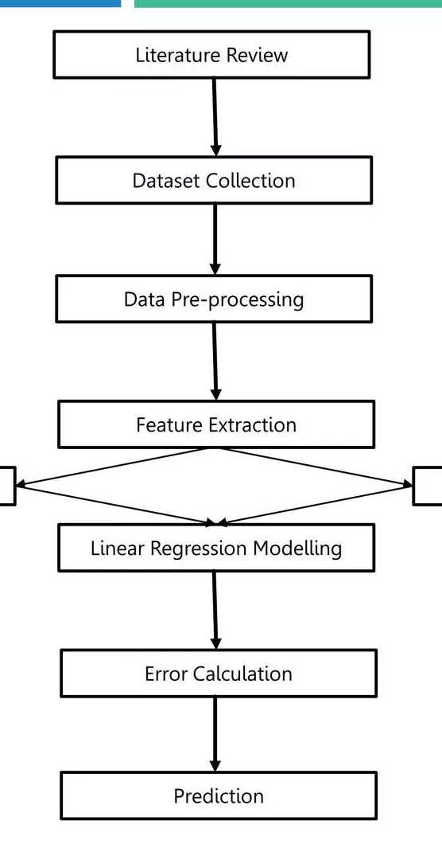
METHODOLOGY:
Training test
Testing test

Slide 7
EXPERIMENT AND RESULTS: dataset:
Brand | Year | Model | Car/Suv | Title | UsedOrNew | Transmission | Engine | DriveType | FuelType | FuelConsumption | Kilometres | ColourExtInt | Location | CylindersinEngine | BodyType | Doors | Seats | Price
0 | Ssangyong | 2022.0 | Rexton | Sutherland Isuzu Ute | 2022 Ssangyong Rexton Ultimate (awd) | DEMO | Automatic | 4 cyl, 2.2 L | AWD | Diesel | 8.7 L / 100 km | 5595 | White / Black | Caringbah, NSW | 4 cyl | SUV | 4 Doors | 7 Seats | 51990
1 | MG | 2022.0 | MG3 | Hatchback | 2022 MG MG3 Auto Excite (with Navigation) | USED | Automatic | 4 cyl, 1.5 L | Front | Premium | 6.7 L / 100 km | 16 | Black / Black | Brookvale, NSW | 4 cyl | Hatchback | 5 Doors | 5 Seats | 19990

Slide 8
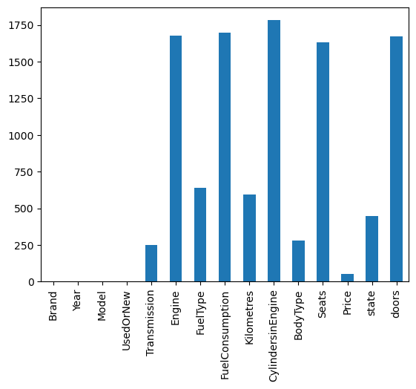
DATA PRE-PROCESSING:
.
Explore each column
Identify null values
data.isna().sum()
Brand 0
Year 0
Model 0
UsedOrNew 0
Transmission 0
Engine 0
FuelType 0
FuelConsumption 0
Kilometres 0
CylindersinEngine 0
BodyType 0
Seats 0
Price 0
state 0
doors 0
dtype: int64

Slide 9
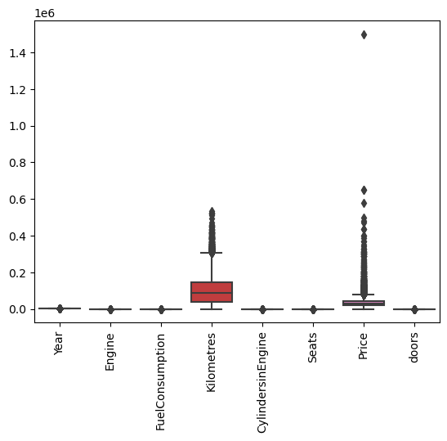
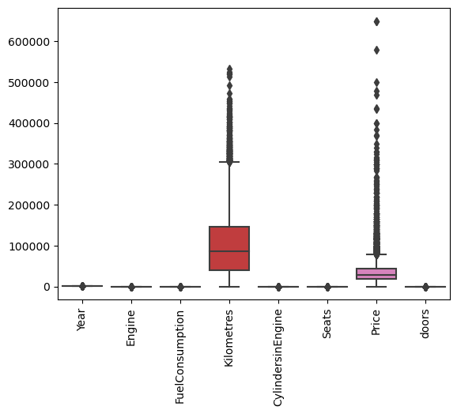
Outliers:

Slide 10
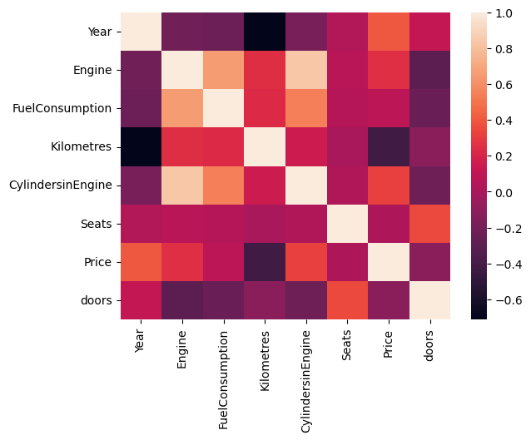
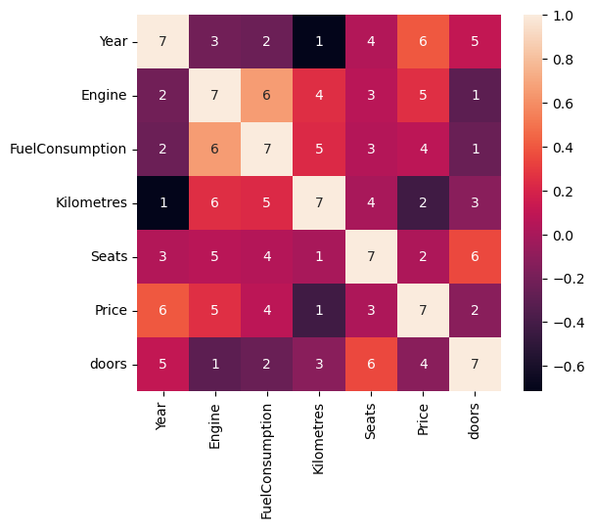
Multicollinearity:
cc
pairs
(CylindersinEngine, Engine) | 0.834206

Slide 11
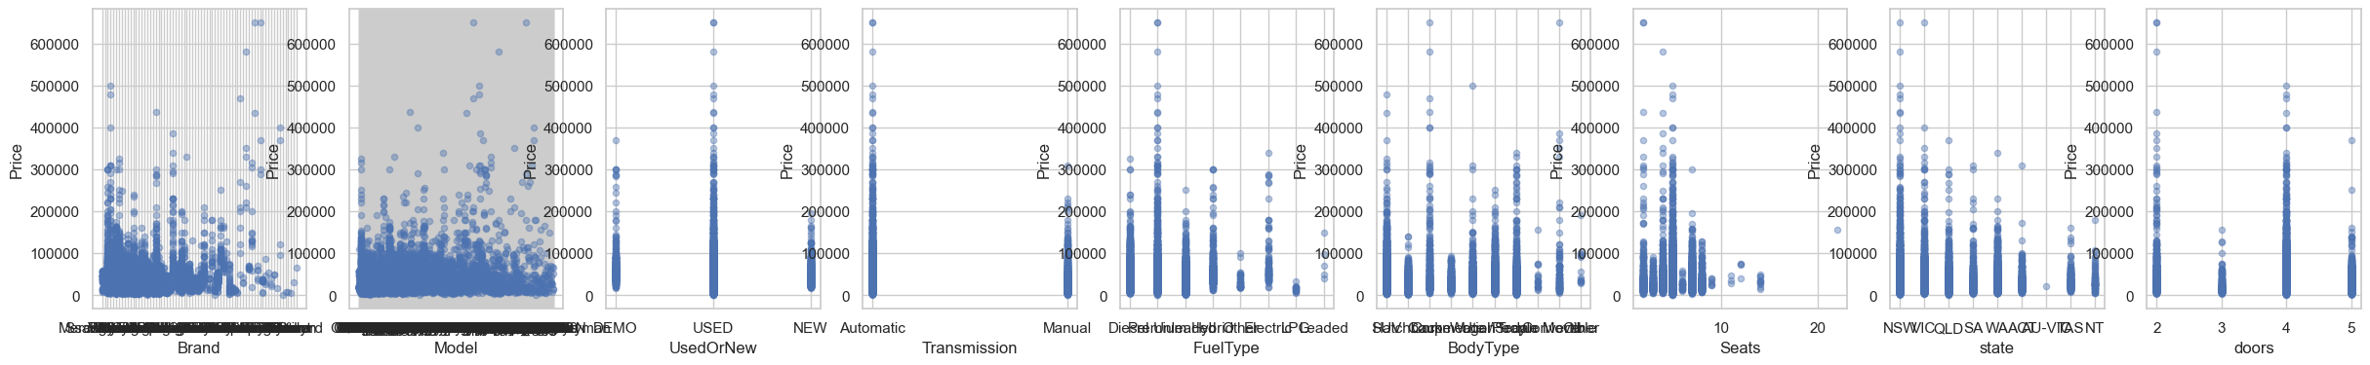
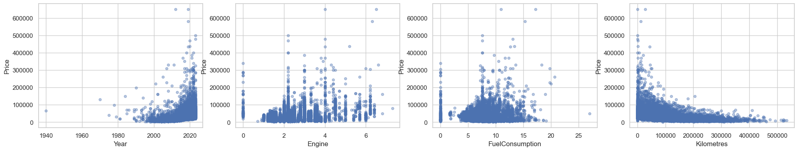
Categorical and numerical columns:

Slide 12
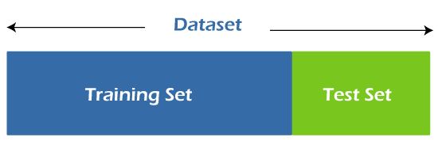
Model:
Linear regression:
print(f’MSE:{mean_squared_error(y_test,data_prediction)}’)
print(f'r2 :{r2_score(data_prediction,y_test)}')
MSE :388473302.45882887
r2 :0.27051509234438886

Slide 13
Error calculation and Get better R2 values:
models = {
'Random Forest': RandomForestRegressor(),
'Decision Tree': DecisionTreeRegressor(),
'SVR': SVR(),
'Linear Regression': LinearRegression(),
'Ada Boost': AdaBoostRegressor(),
'Gradient Boost': GradientBoostingRegressor()
}
Random Forest Metrics:
Accuracy: 0.7648379976163262
Mean Squared Error: 213362546.83111653
Mean Absolute Error: 5707.514425858378

Slide 14
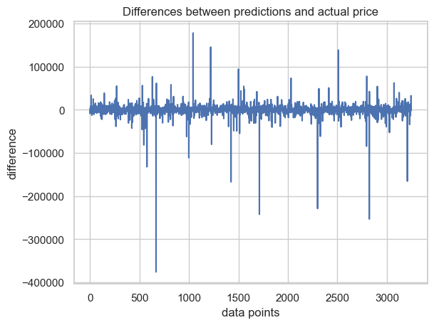
Model: Random forest:
In [173]:
rf_pred = model_rf.predict(X_test)
print(f'MSE :{mean_squared_error(y_test,rf_pred)}’)
print(f'r2 :{r2_score(rf_pred,y_test)}')
MSE :229121151.50966263
r2 :0.6629115105047323

Slide 15
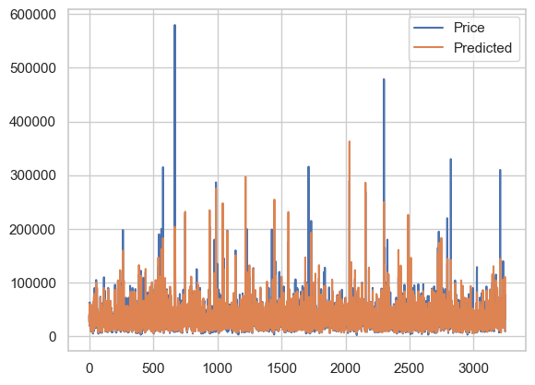
ACTUAL VS PREDICTED PRICE:
index Price Predicted
6183 25990.0 28766.770000
6402 39990.0 41108.730000
10979 28990.0 29413.354545
14368 52990.0 43930.940000
14693 62984.0 60261.640000
... ... ...
6100 29830.0 30199.670000
3023 45000.0 44784.120000
9638 77990.0 110593.820000
12039 11990.0 11083.510000
13783 8990.0 9753.770000

Slide 16
PREDICT PRICE WITH VALUES:
predict_price("Audi",’USED','Manual','Unleaded', 'SUV','7', 'NSW', '4', 2020, 2, 4.2,23446)
36014.95

Slide 17
CONCLUSION:
In this project, a liner regression model was successfully implemented employing various prominent algorithms from the python libraries and modules.
After the collection of data was done, pre-processing of data was done. The null entries and missing datapoints were removed from the dataset and the categorical variables were also processed using dummy variable technique.
The r2 score of linear regression was 76.8% .

Slide 18
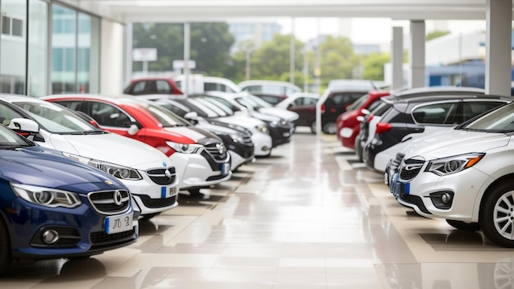
THANK YOU

